Slide 1

Windows Networks and File Permissions
Team Pi

Slide 2
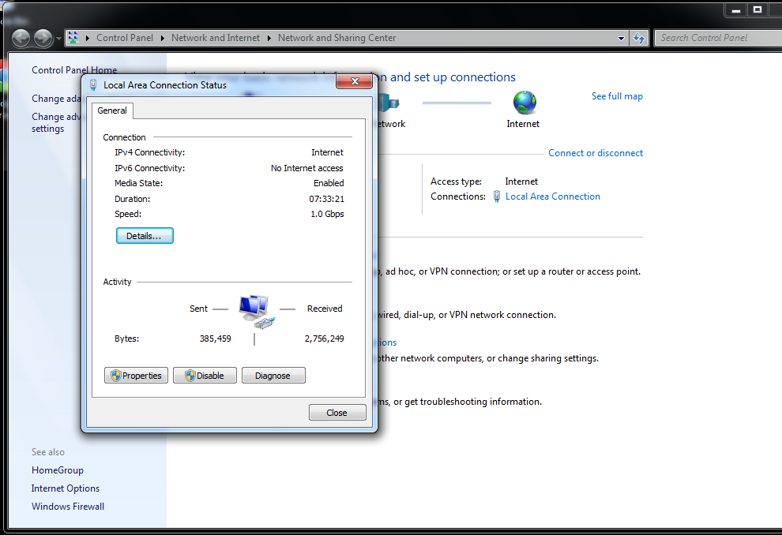
Access Network Properties of Network Card
7/8
In the Network and Sharing Center just click on your connection and the you can click on properties

Slide 3
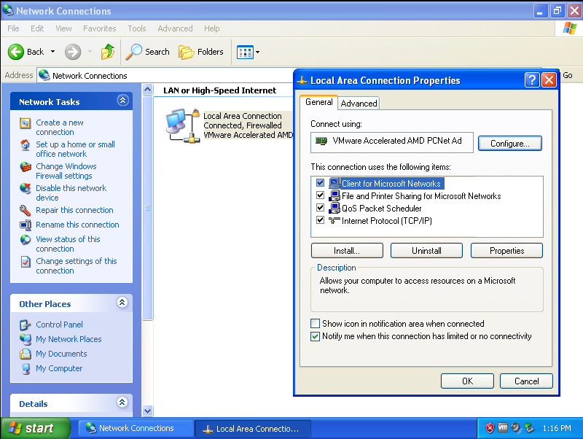
Access Network Properties of Network Card
XP
Control Panel->Network and Internet Connections-> Network Connections, right click the network and select properties.

Slide 4
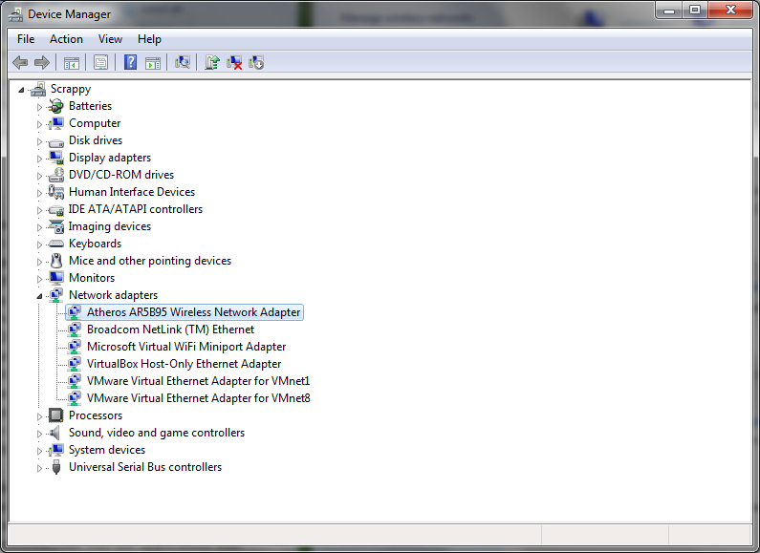
Update Network Card Drivers
XP/7/8
Open ‘Device Manager’, expand network adapters, right click adapter and then select ‘Update Driver Software’

Slide 5
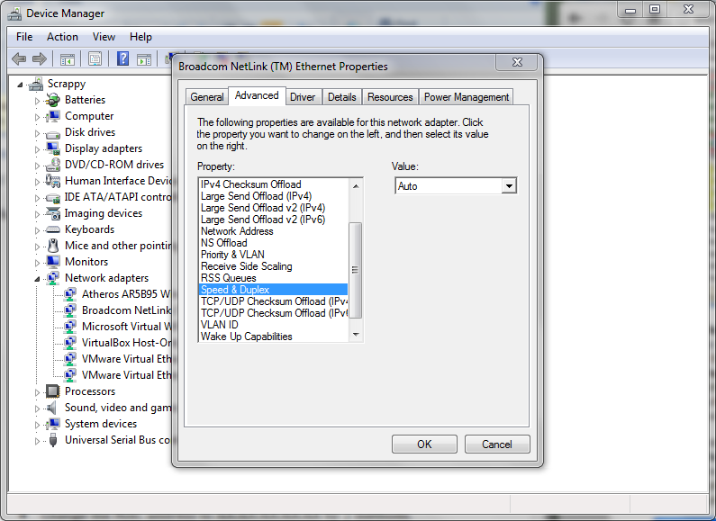
Link Speed and Duplex Value Set to Auto Negotiation.
XP/7/8
Open ‘Device Manager’, expand network adapters, right click adapter and then select ‘Properties’. Then under the ‘Advanced’ tab select ‘Speed & Duplex’ and click auto.

Slide 6
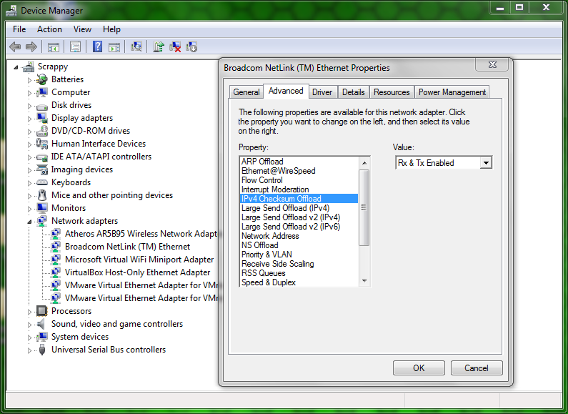
TCP/UDP Checksum Offload (IPv4) is Enabled
XP/7/8
Navigate to same menu as Speed & Duplex, select ‘IPv4 Checksum Offload’ and click ‘Rx & Tx Enabled’

Slide 7
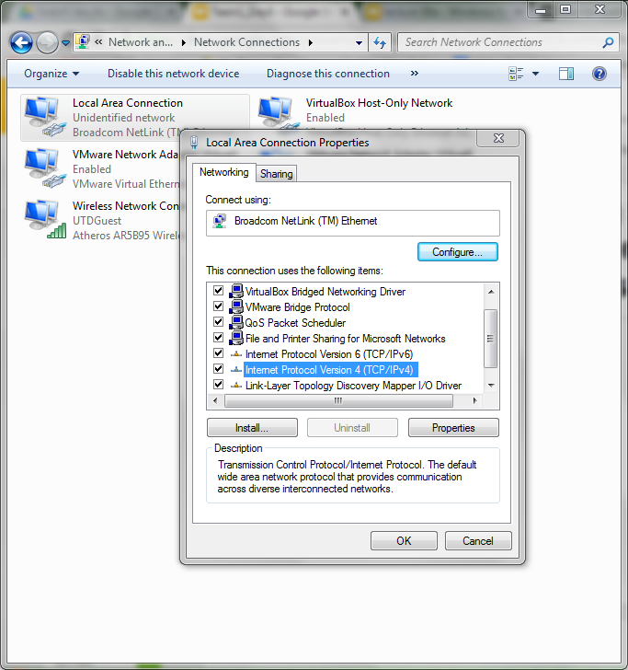
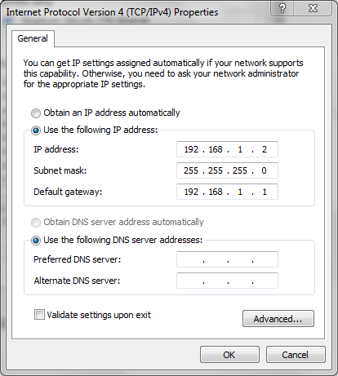
Configuring Static IP addresses on Team Server and Laptops
XP/7/8
Open ‘Network and Sharing Center’, click ‘change adapter settings on the right side. Right click the network, properties. Right click IPv4, properties, set IP

Slide 8
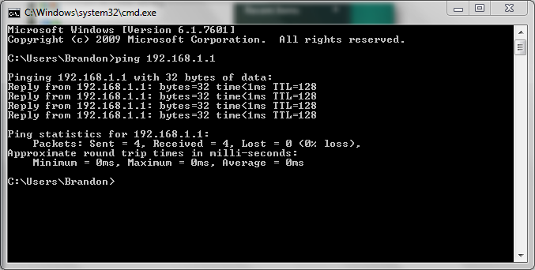
Configuring Static IP addresses on Team Server and Laptops
After all the computers have been set ping one to test.

Slide 9
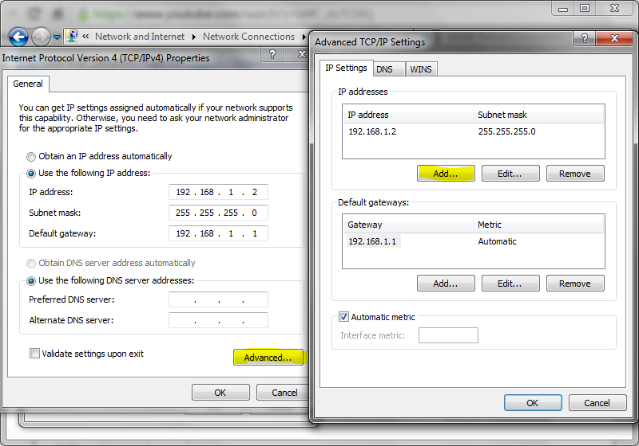
Making Team Server Dual Homed
Navigate to previous window. Click ‘Advanced’ Click ‘Add’ and enter a new IP address on a different subnet.

Slide 10
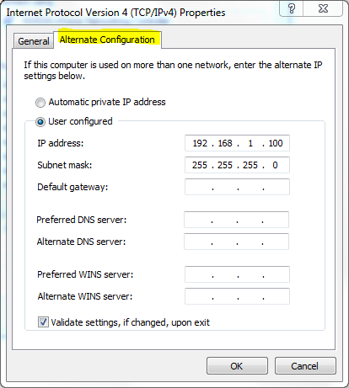
Configuring Team Server to Have Dynamic and Static IP Address
Again navigate to the same menu. Click on the ‘Alternate Configurations’ tab. If DHCP is unavailable it will use this address.

Slide 11
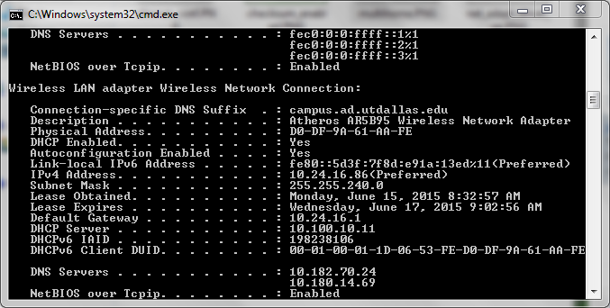
Finding Lease Obtained and Expiration Dates for Team Server
Open cmd, type ‘ipconfig /all’
DHCP lease info will be listed.

Slide 12
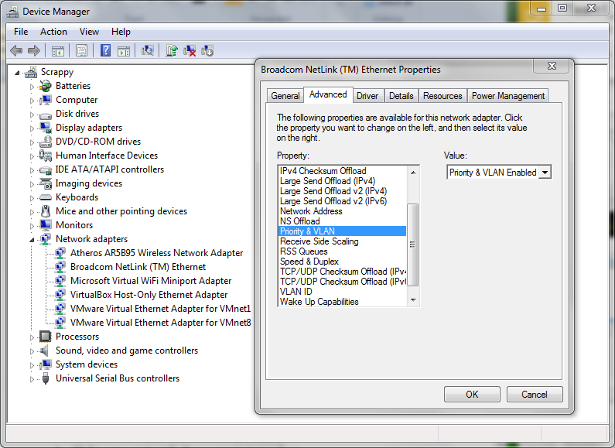
Priority and VLAN enabled
XP/7/8
Open ‘Device Manager’
Right Click the network adapter, go to ‘Advanced’ tab, select Priority and VLANS, select Enabled on the drop down menu.

Slide 13
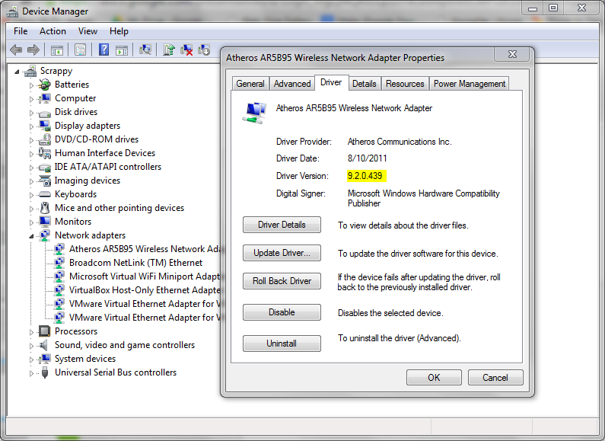
Finding Driver Version Number
XP/7/8
Same GUI as before, click on ‘Driver Tab’, Driver version is displayed.

Slide 14
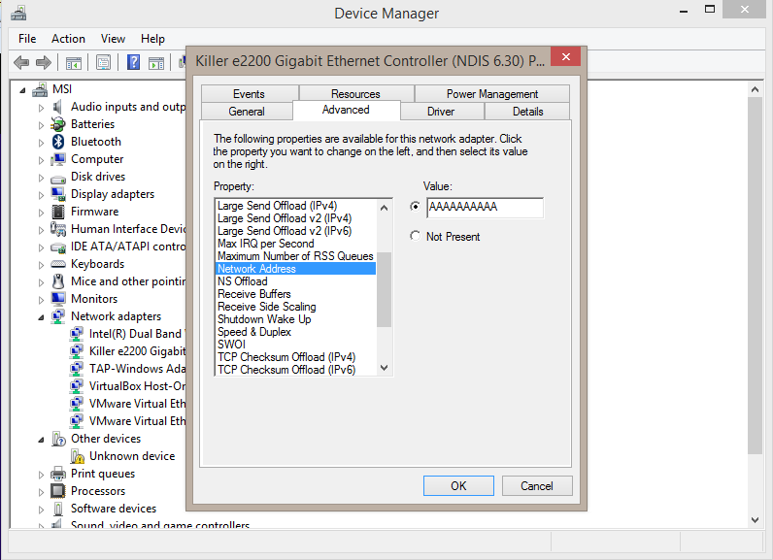
Changing MAC address to AA:AA:AA:AA:AA
(Method 1)
XP/7/8
In the device manager click on your network adapter and go to properties then advanced. Scroll down to Network Address and input the value you want

Slide 15
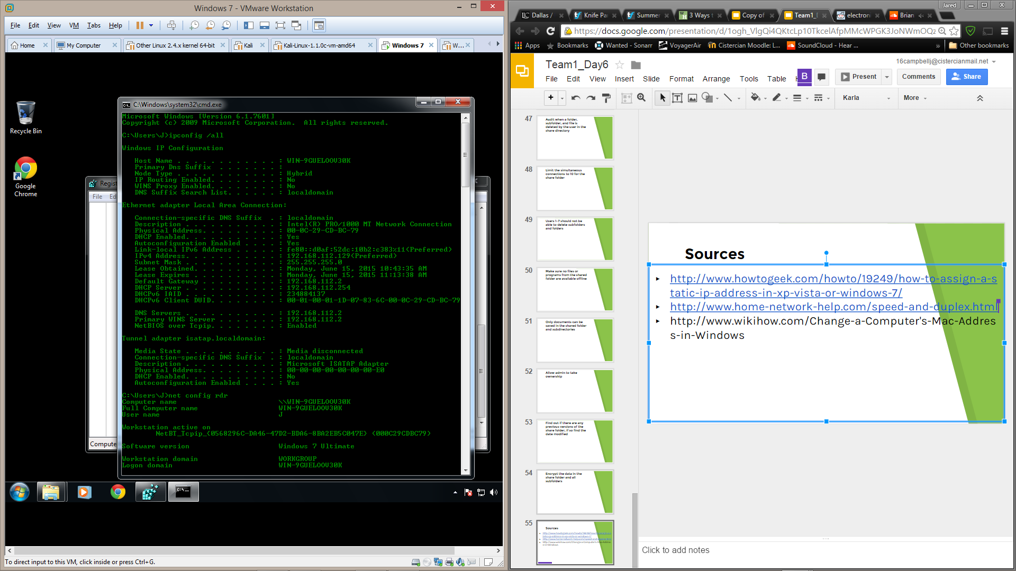
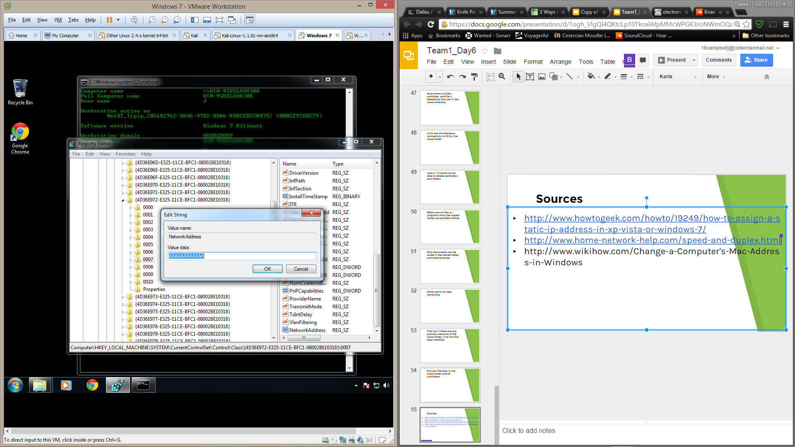
Changing MAC address to AA:AA:AA:AA:AA
(Method 2)
XP/7/8
Fist open cmd and type “ipconfig /all”. Note the description and physical address of your network device. Also type “net config rdr” and note the GUID.
Then open REGEDIT and navigate to HKEY_LOCAL_MACHINE\SYSTEM\CurrentControlSet\Control\Class\{4D36E972-E325-11CE-BFC1-08002BE10318}. There will be several folders labeled "0000", "0001", etc. Open each of these and compare the DriverDesc field to the Description you noted in the first step. Right click on the folder you want and add a new String Value called “NetworkAddress”. Then add the MAC address you want into the string.

Slide 16
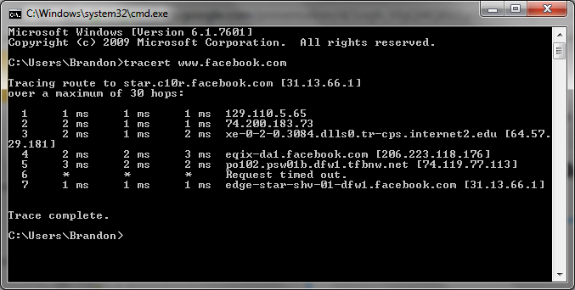
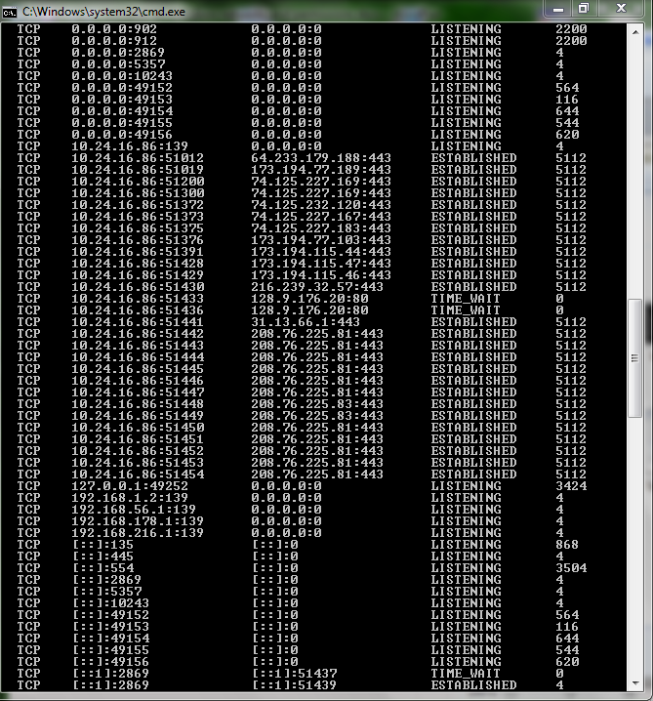
Finding PID and Port Number
XP/7/8
Use the command ‘tracert <domain>’ to find the IP of the website. Then use the command ‘netstat -a -n -o’ t list all connections. The local address, external address, status, and PID are displayed. (Addresses include port)

Slide 17
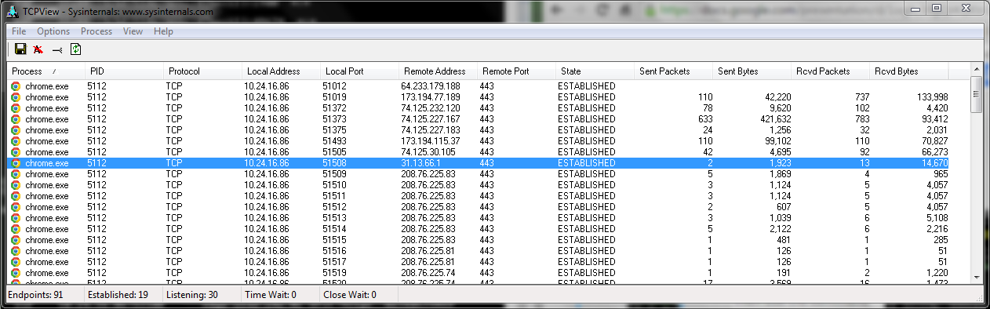
Using TCPVIEW tool
XP/7/8
TCPVIEW is a program for windows used for detailed listing of TCP and UDP connections. It displays similar information to the ‘netstat’ command. Here is facebook.com

Slide 18
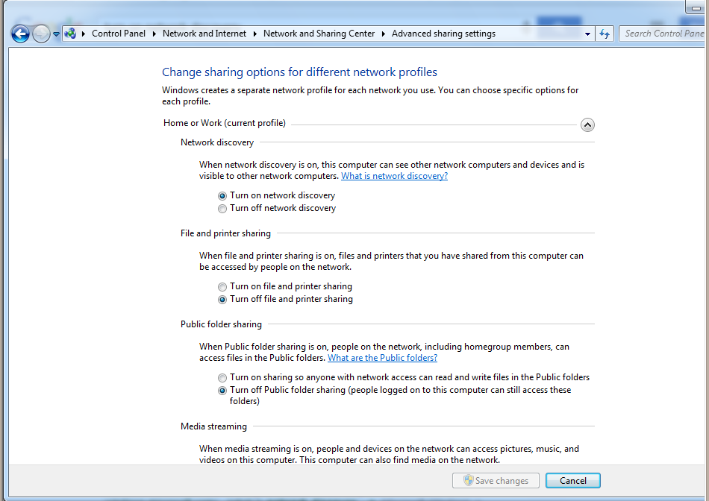
Network Discovery Turned On and File and Printer Sharing Turned off
7/8
Go to the Network and Sharing Center and click Advanced Sharing Settings on the left.

Slide 19
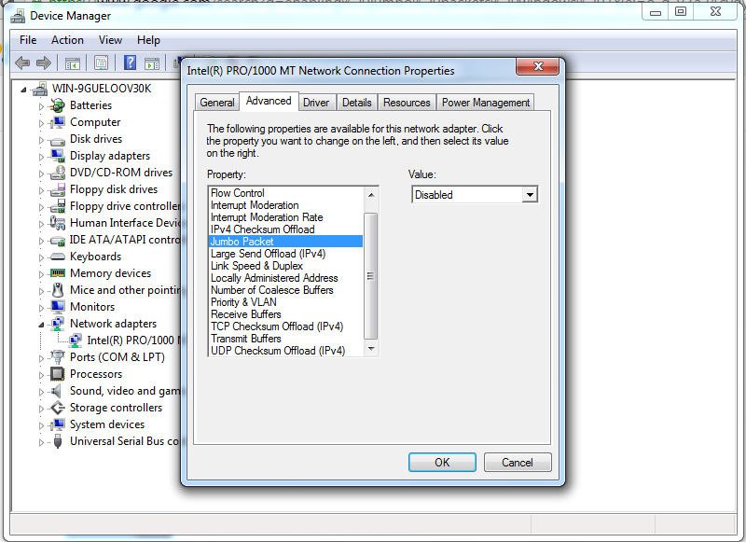
Disabling Jumbo Packets
XP/7/8
Open Device Manager and navigate to the advanced properties of your network adapter. Scroll down to Jumbo Packet and make sure it is disabled

Slide 20
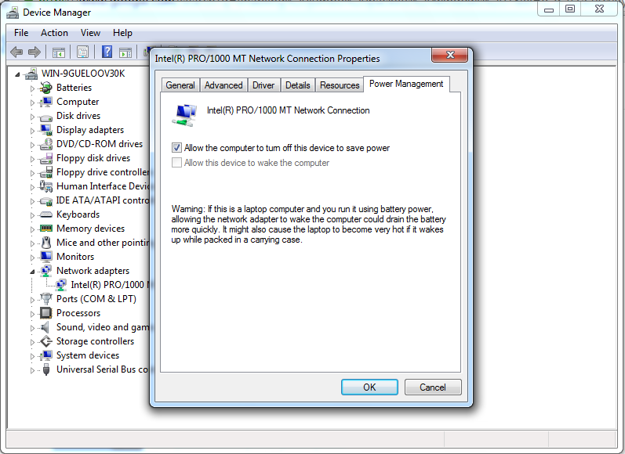
Allowing Computer to Turn Off Device to Save Power
XP/7/8
In Device Manager navigate to the Power Management tab of the properties of your network adapter

Slide 21
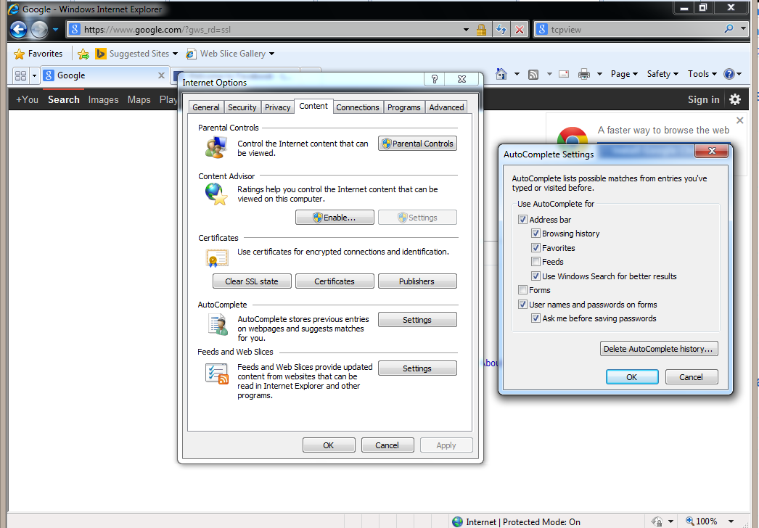
Deleting All Autocomplete History
XP/7/8
Open Internet Explorer and click on tools then select Internet Options. Click on the Content tab and the Settings under AutoComplete. Then just click Delete AutoComplete History

Slide 22
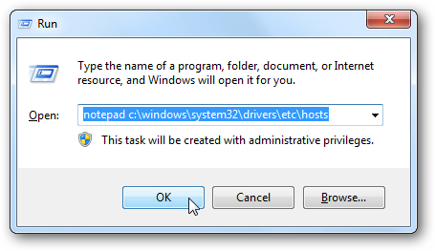
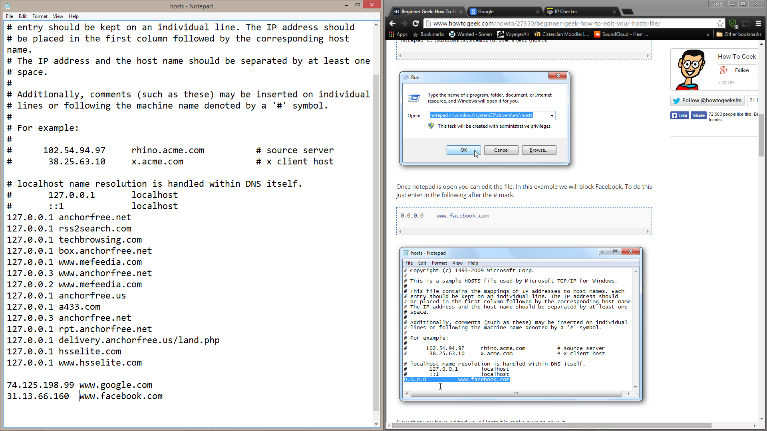
Configuring Host File
XP/7/8
Open run and type “notepad c:\windows\system32\drivers\etc\hosts” into it to open the host file. In the file type the IP address of the website followed by the DNS name you want to associate it with.

Slide 23
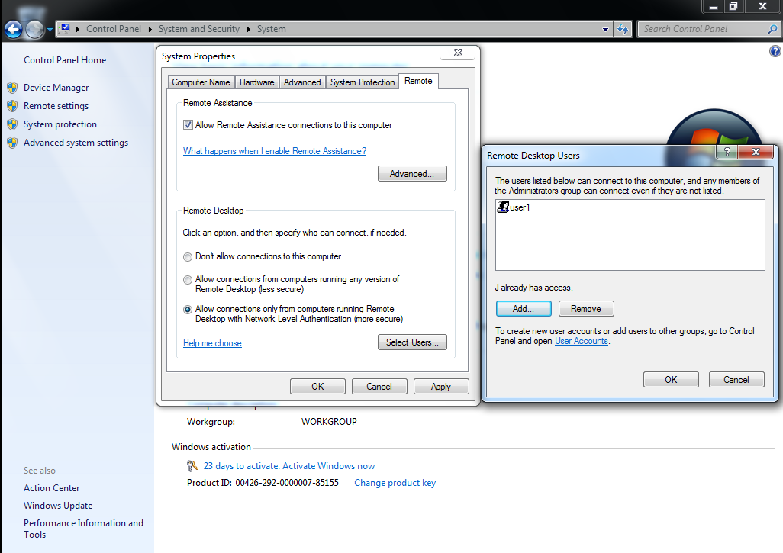
Configure Remote Desktop
7/8
Open the Control Panel and go to System. Click Remote Settings on the left. Decide which option you want for allowing remote connections. Click select users and the add to add which users have remote desktop access.

Slide 24
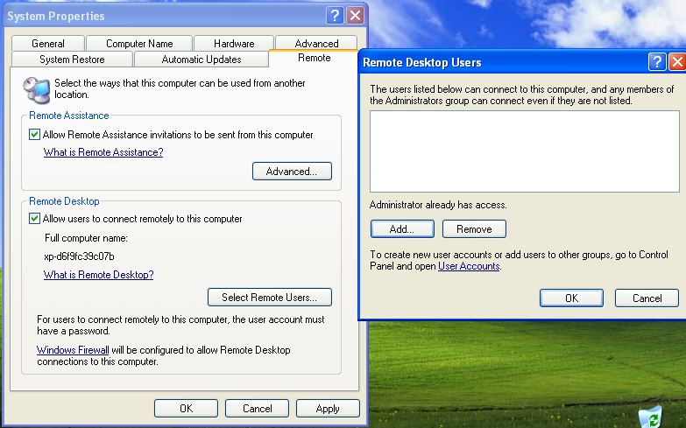
Configure Remote Desktop
XP
Click the Start Button, right click ‘My Computer’. Select the ‘Remote’ tab and click ‘Remote Users’.

Slide 25
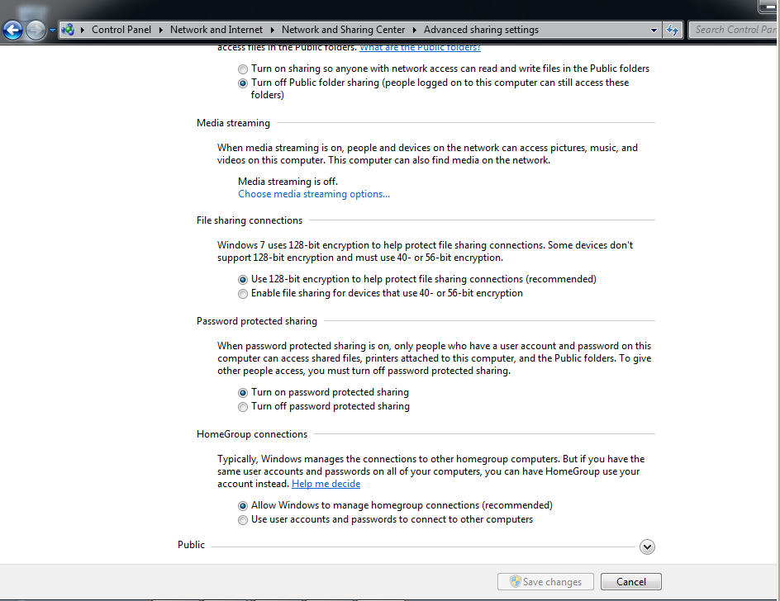
Use 128-bit Encryption for File Sharing
7/8
In the Network and Sharing Center click Advanced Sharing Settings on the sidebar. Scroll down and you’ll see the option to encrypt file sharing

Slide 26
File Permissions

Slide 27
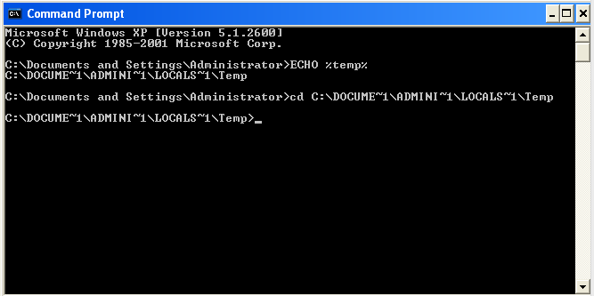
Finding the Temp File
You can find the Temp file by using the ECHO command in the Command Prompt. Now that you have the pathname you can interact with the folder’s contents.

Slide 28
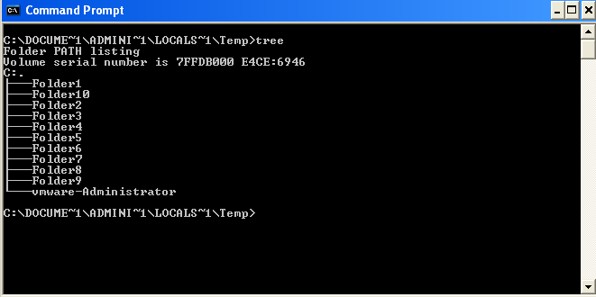
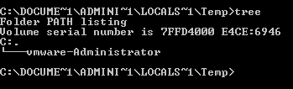
Checking and Adding Folders
Use the command “tree” to get a list of all files within your current directory.
Use the MD command to make a new folder within your current directory.

Slide 29
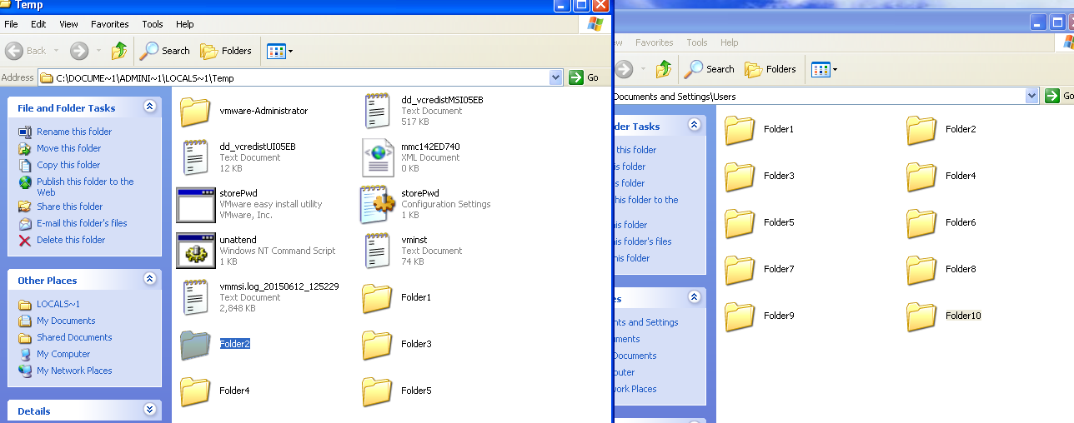
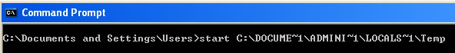
Moving Folders
Next we had to copy folders 1-5 and move folders 6-10 to the Users folder, to do this I opened an explorer window from the cmd prompt and moved the files from there.
This is the command used to open an explorer window at a destination folder (my temp folder).

Slide 30
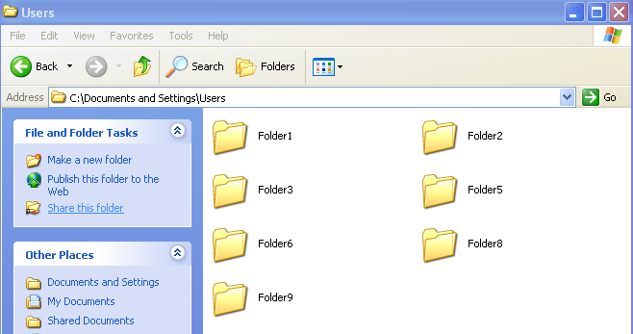
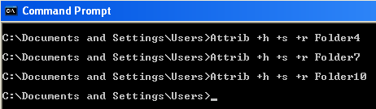
Hiding Folders
To hide folders use the command,
Attrib +h +s +r <Folder Name>. This keeps the files in the same location, but hides them from view in explorer windows, and can be undone by using the command.
Attrib -h -s -r <Folder Name>

Slide 31
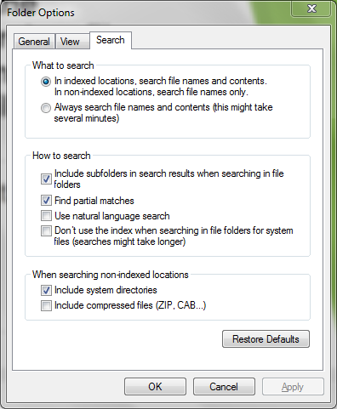
Configure so the computer searches file names, contents, and compressed files
Open the start menu and type folder options. Click the ‘Always search file names and contents’ radio button and check the box at ‘Include compressed files’

Slide 32
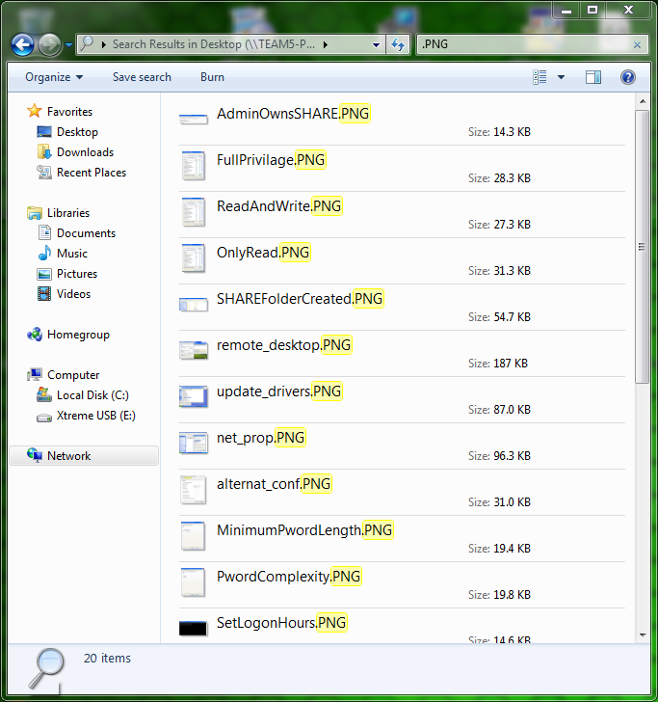
Give the search command that can be used to search all txt files in a given drive
To search a file type, type dot and then the file extension in the search bar.

Slide 33
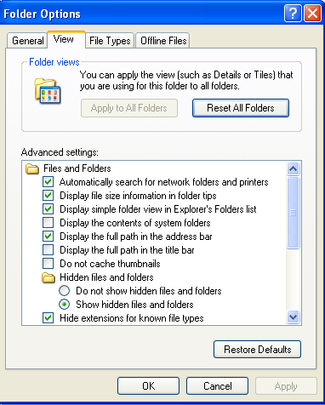
Show all the hidden files and their extensions
To show hidden files, use the control panel and navigate to the folder options under Themes and Appearance.

Slide 34
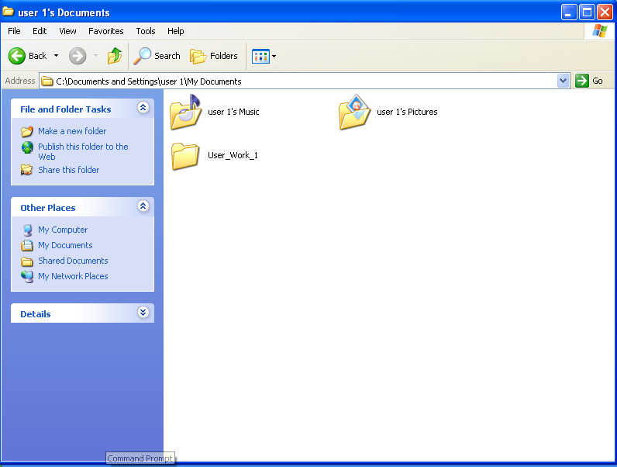
Create 15 folders, one in each user’s home directory and name it user_work_1 - 15
This is a simple navigation to a user’s home folder to add a folder for them to use.

Slide 35
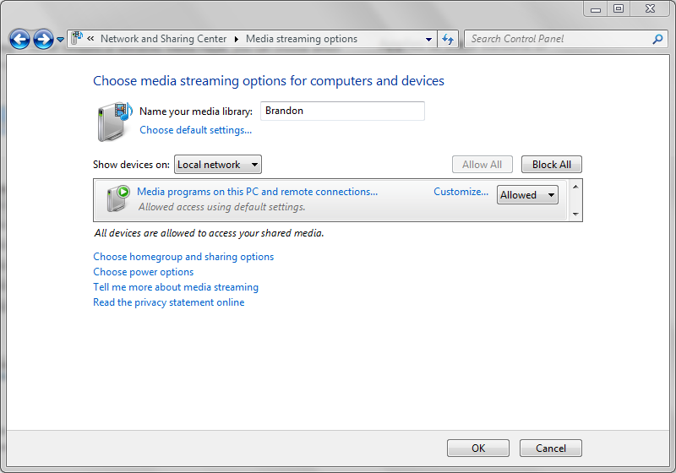
Enable media streaming options and let the devices be shown only on local network
Open ‘Media streaming options’ in Control Panel and in the drop down menu select ‘Local network’

Slide 36
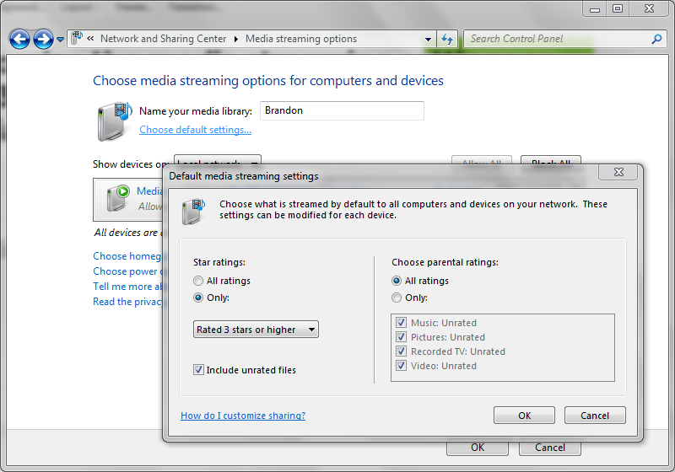
Customize the media streaming settings so that 3 star and above media and unrated media with parental settings is streamed
Open ‘Media streaming options’ in Control Panel and click ‘Choose default settings’. Check ‘Include unrated files’ and select ‘Only:’ in the star ratings and choose three stars or higher in the drop down menu.

Slide 37
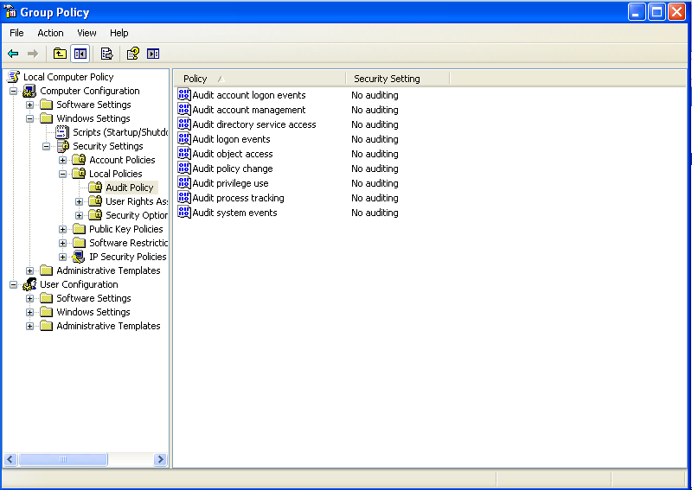
Audit when a folder is successfully created by the user in their home directory
Auditing folders is enabled through the Group Policy Editor.

Slide 38
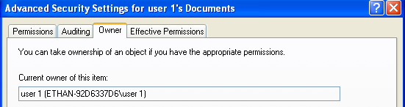
Change the owner of the user home folders to the corresponding user
This is done in the advanced security section of a folder’s properties.

Slide 39
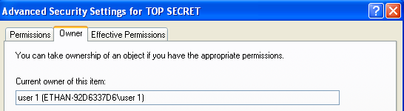
Make a folder named TOP SECRET and make user1 the owner
User 1 has taken full ownership of TOP SECRET.
He now has the power to deny access to any other user.

Slide 40
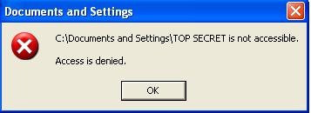
Deny access to TOP SECRET to anyone except user1
This is a message I recieved on my admin account after having taken privileges from everyone but User 1.

Slide 41
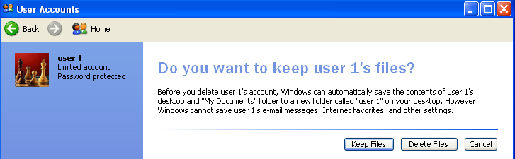
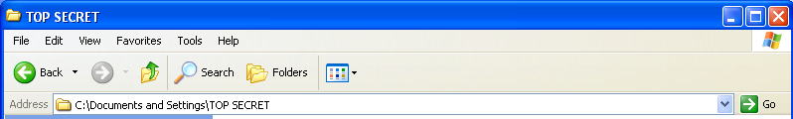
Delete user1 and access TOP SECRET
After deleting user 1 I was able to access the TOP SECRET folder again because it no longer had an owner, as such I was able to take ownership of the folder and change permissions to allow myself back in.

Slide 42
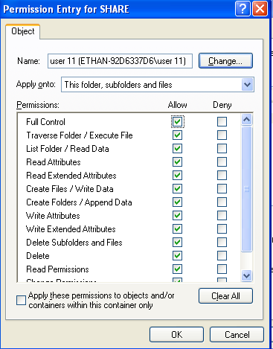
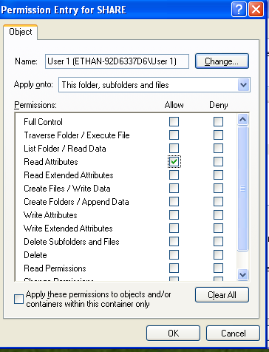
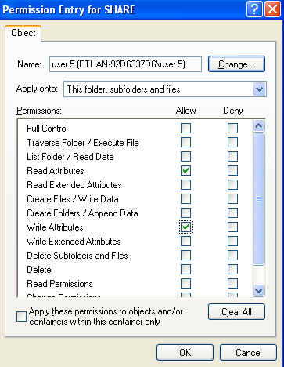
Add user1 and create a folder called SHARE which is shared so that users1 - 5 can read, 5-10 can write, and group 3 has full access

Slide 43

Give admin ownership of the share folder

Slide 44
Enable smb signing
In 2006 Windows came out with new version that made significant changes. Both are now included in Windows and can be enabled/disabled separately. The version numbers are 10 and 20 with 10 being 1 and 20 being 2.

Slide 45
Enable smb signing
To enable SMB use the following commands:
sc.exe config lanmanworkstation depend= bowser/mrxsmb10/mrxsmb20/nsi
sc.exe config mrxsmb<version-number> start= auto
To disable:
sc.exe config lanmanworkstation depend=
bowser/mrxsmb<version-number>/nsi
sc.exe config mrxsmb<version-number> start= disabled

Slide 46
Audit when a folder, subfolder, and file is deleted by the user in the share directory
Use the auditing method shown earlier in the presentation to audit functions of the SHARE folder.

Slide 47

Limit the simultaneous connections to 10 for the share folder
Open the folder properties and set maximum amount of users.

Slide 48

Users 1-7 should not be able to delete subfolders and folders
Under permissions gone over before, make sure they are not allowed to delete.

Slide 49

Make sure no files or programs from the shared folder are available offline
Selecting the option that documents cannot be cached will stop users from accessing them while offline.

Slide 50

Only documents can be saved in the shared folder and subdirectories
Under the folder properties, in the ‘Customize’ tab, select Documents in the template drop down.

Slide 51

Allow admin to take ownership
Right click the folder, then click ‘Advanced’, then ‘Change Permissions’, select the Admin and click ‘Edit’. Make sure the ‘Allow’ box is checked for ‘Take ownership’ to allow the admin to take ownership.

Slide 52
Find out if there are any previous versions of the share folder, if so find the date modified
By going under the view tab in Windows Explorer you can tell windows to show details, this will cause folders to show their last modified dates.

Slide 53

Encrypt the data in the share folder and all subfolders
In folder properties, under ‘Advanced Attributes’ check the ‘Encrypt contents to secure data’.

Slide 54
Sources
http://www.howtogeek.com/howto/19249/how-to-assign-a-static-ip-address-in-xp-vista-or-windows-7/
http://www.home-network-help.com/speed-and-duplex.html
http://www.wikihow.com/Change-a-Computer's-Mac-Address-in-Windows
https://communities.intel.com/thread/40955
http://www.techspot.com/community/topics/is-there-a-way-i-can-find-out-when-the-dhcp-lease-will-expire-for-a-internet-ip.104336/
http://www.howtogeek.com/howto/19249/how-to-assign-a-static-ip-address-in-xp-vista-or-windows-7/
https://technet.microsoft.com/en-us/library/bb897437.aspx

